Slide 1
DCAITI-Project: Implementation of a Traffic Light Service on an (Android) Smartphone
Oday Kabha oday.kabha@ipk.fraunhofer.de
Yiyang Song yiyang.song@campus.tu-berlin.de
Yuanheng Mu johanmu1994@mailbox.tu-berlin.de
Supervisor: Birgit Kwella
Notes:
<number>

Slide 2
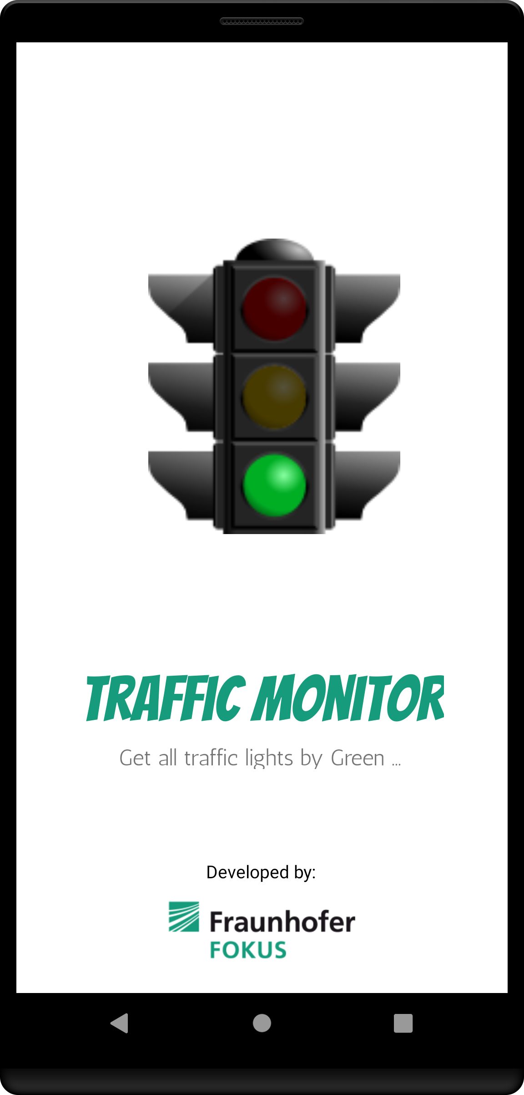
Overview
Background
Secure Android Application
Features
Layout
General Class Diagram
System Architecture
Main Tasks (Implementation, Simulation and Test)
Milestones
Licenses
1
10.02.2021
DCAITI -Projekt

Slide 3
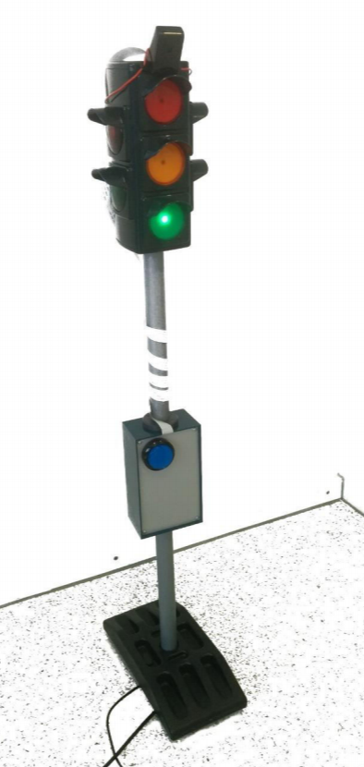
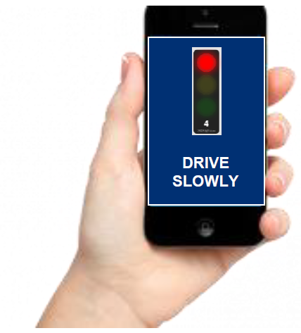
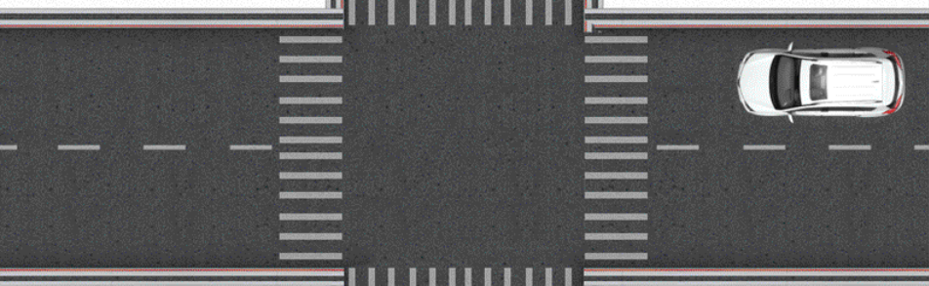
1. Background
GLOSA (Green Light Optimized Speed Advisory)
suggests speeds to vehicles to pass through an intersection
RSU (Roadside unit)
SPaT (Signal Phase and Time)
FOKUS Traffic Light Service
MAP (Map data)
Topology of the intersection
Road Users
car/ bicycle/ pedestrian
receive recommendation for action
RSU
SPaT & MAP
via automotive WiFi
Source: Lecture slides. First lecture
1
10.02.2021
DCAITI -Projekt
Notes:
<number>

Slide 4
2. Secure Android Application
Application
Secure Java
Code
Secure XML
Code
Secure Class
Architecture
1
10.02.2021
DCAITI -Projekt
Notes:
<number>

Slide 5
3. Features
TrafficMonitor
Notification
Receiver
Location
Receiver
Shared
Preferences
Other Features
(see slide 13)
1
10.02.2021
DCAITI -Projekt

Slide 6

4. Layout (Splash Screen)
1
10.02.2021
DCAITI -Projekt

Slide 7
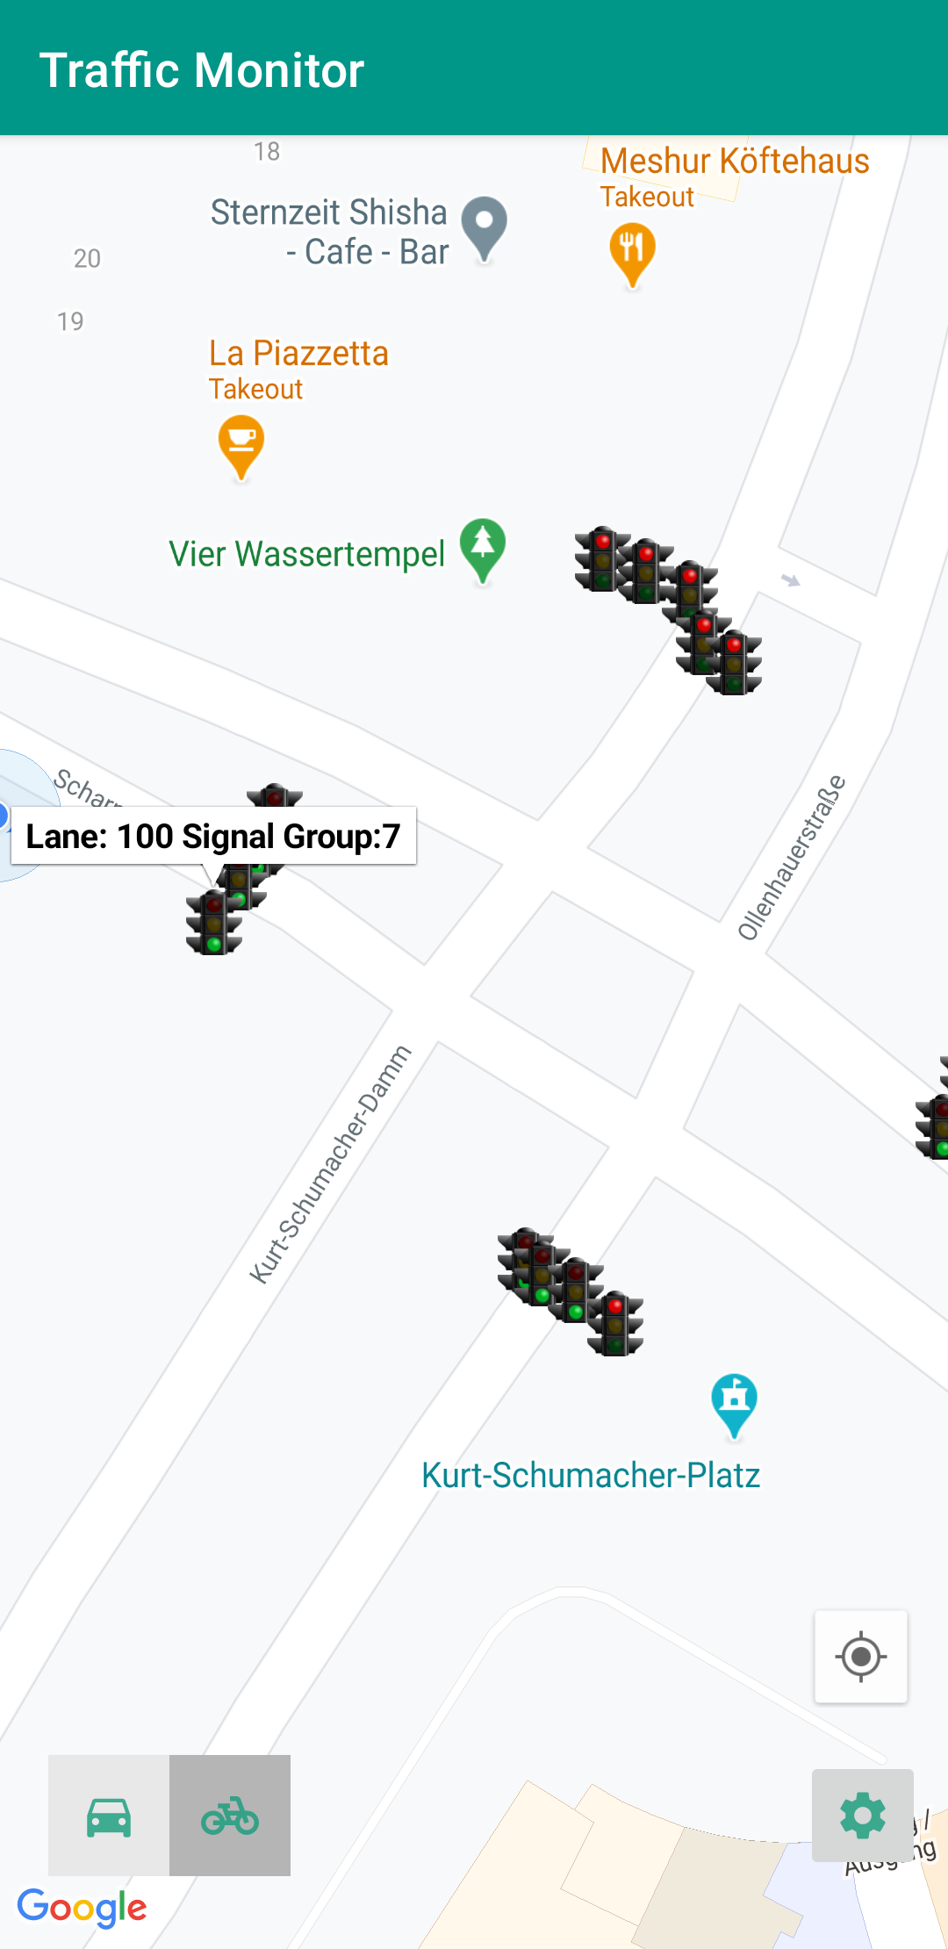
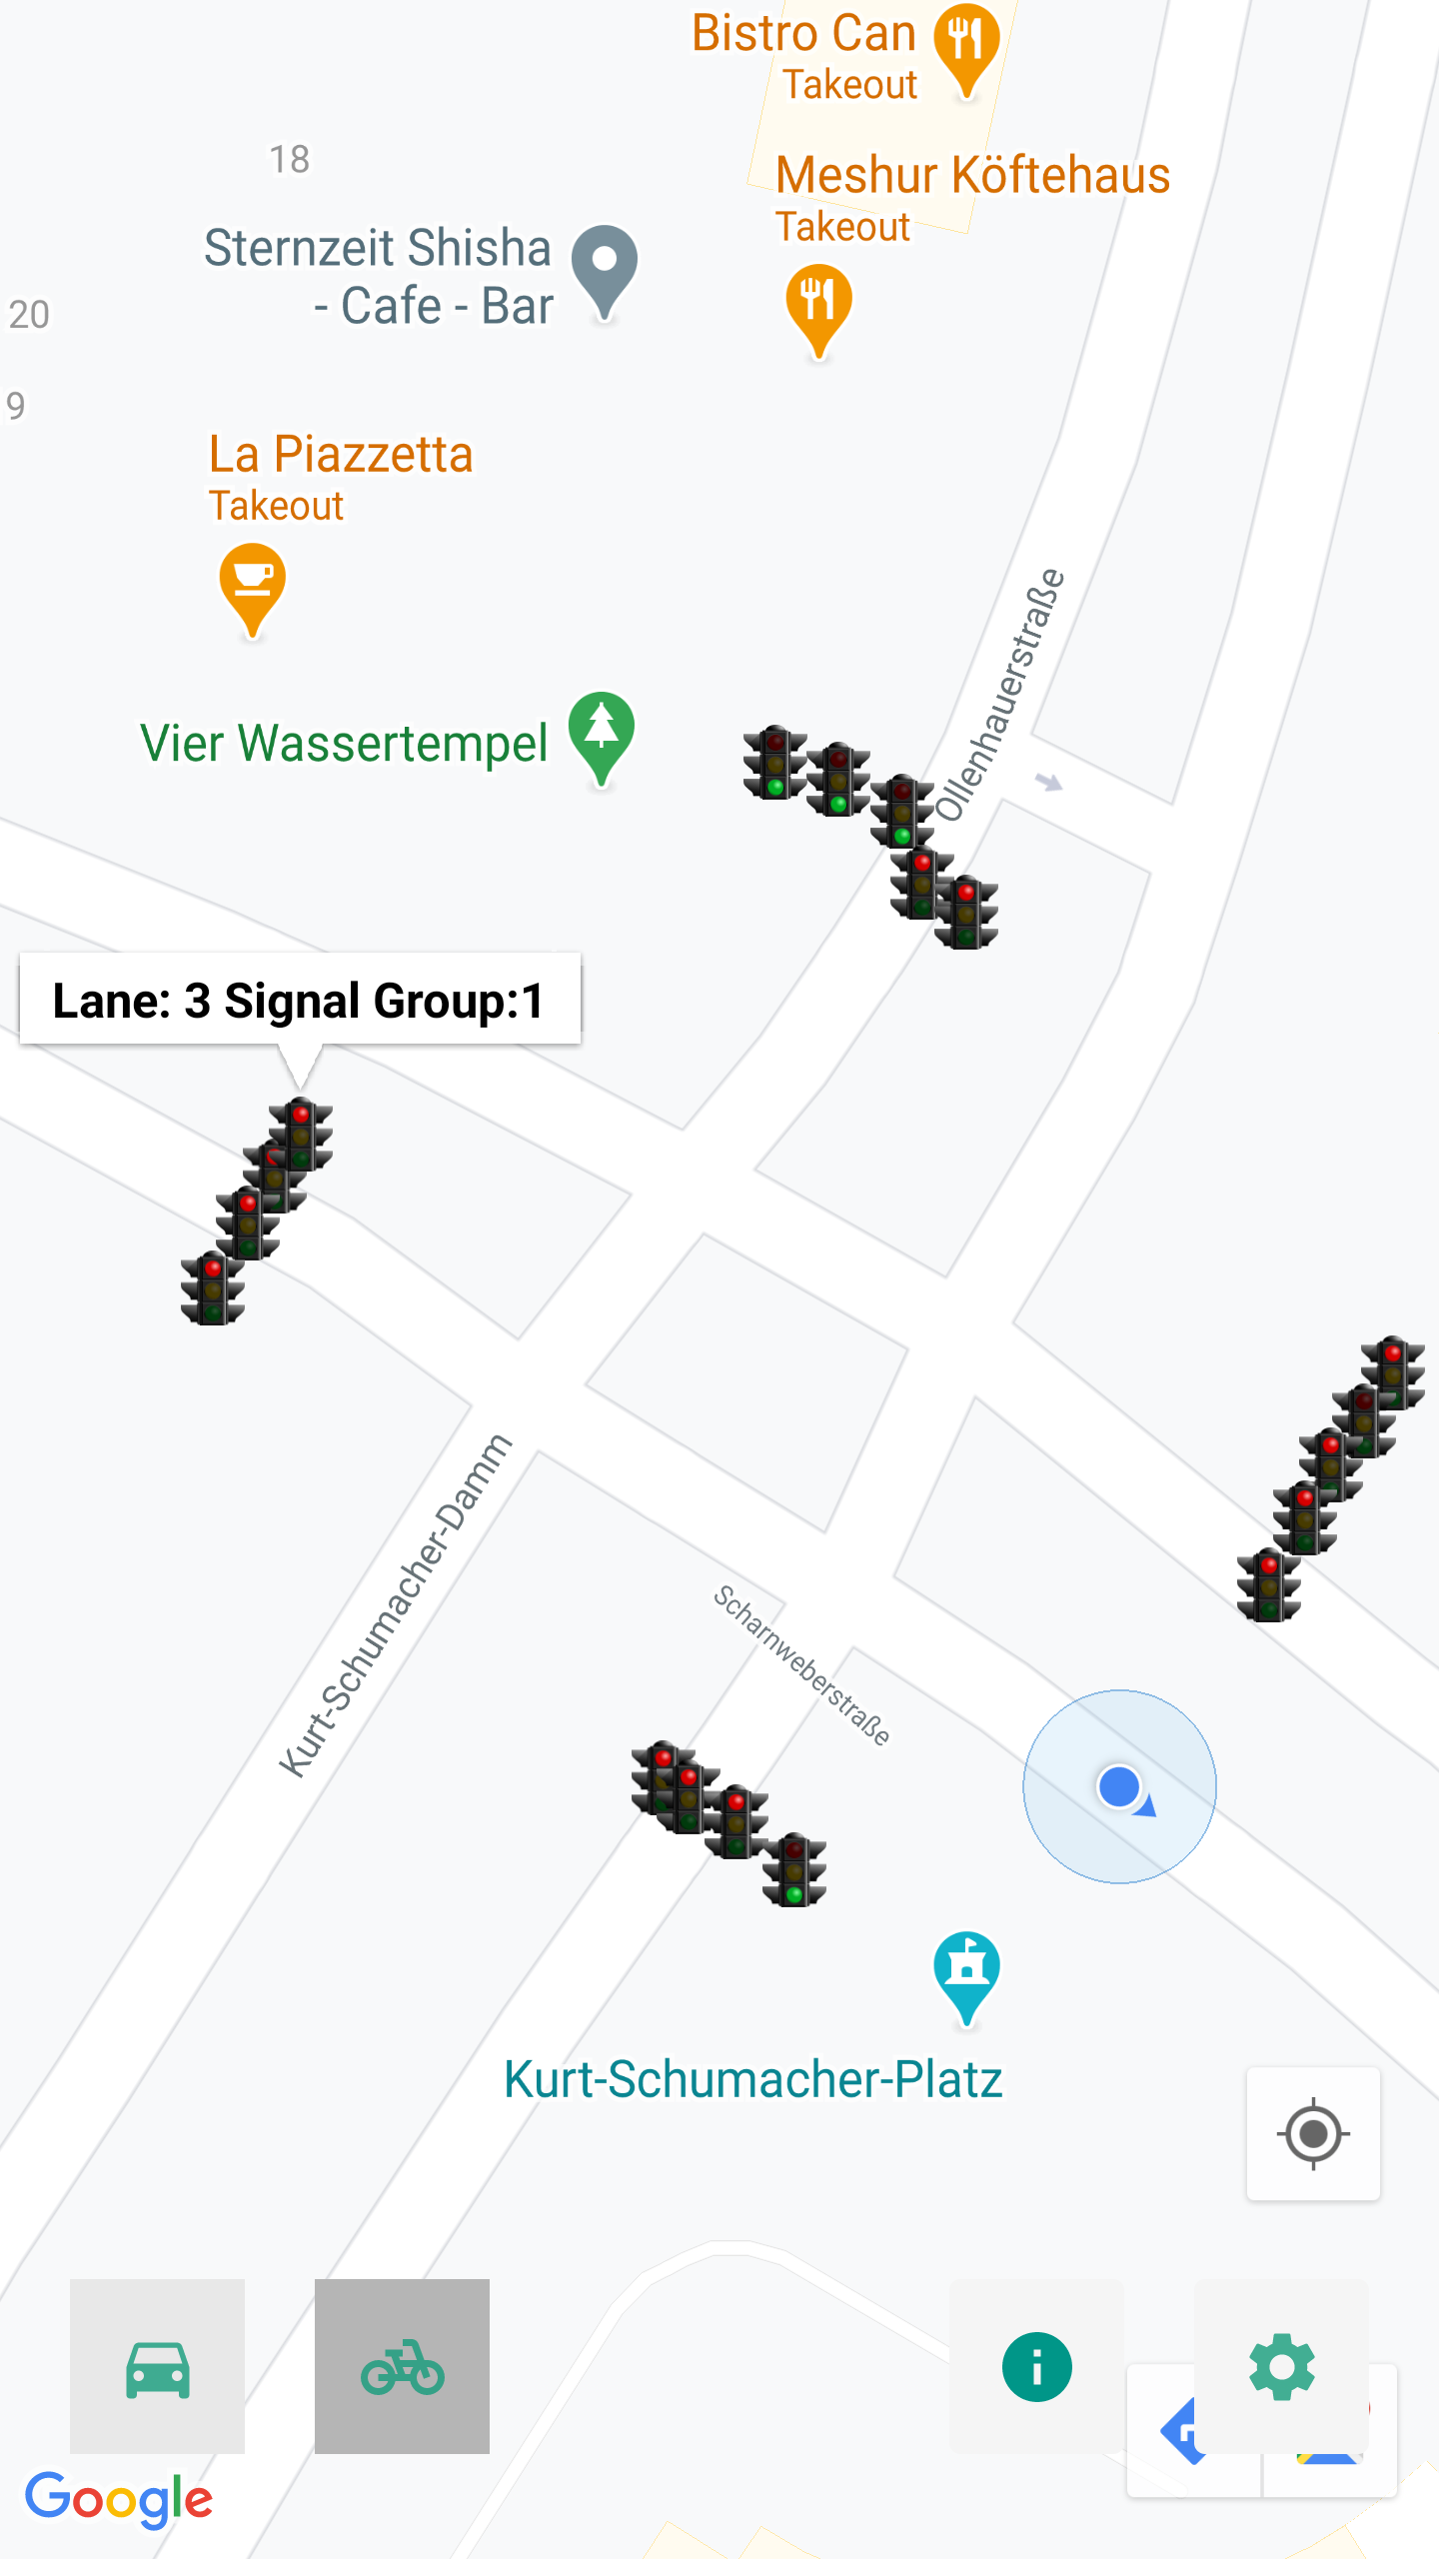
4. Layout (Main Screen)
1
10.02.2021
DCAITI -Projekt

Slide 8
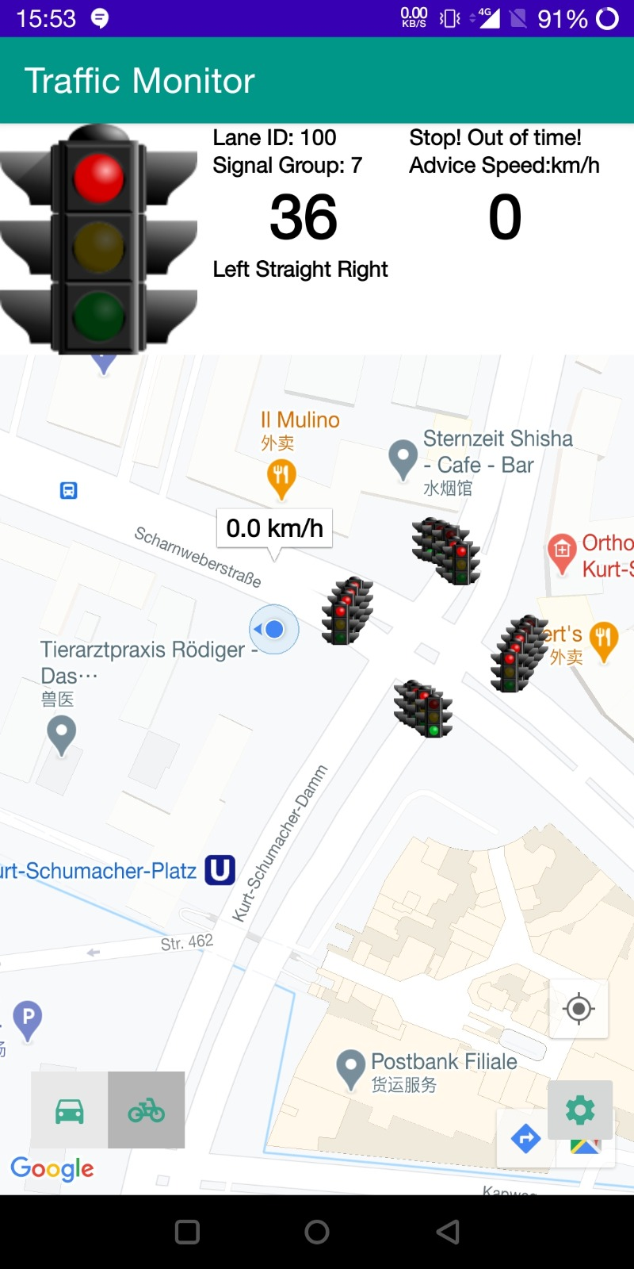
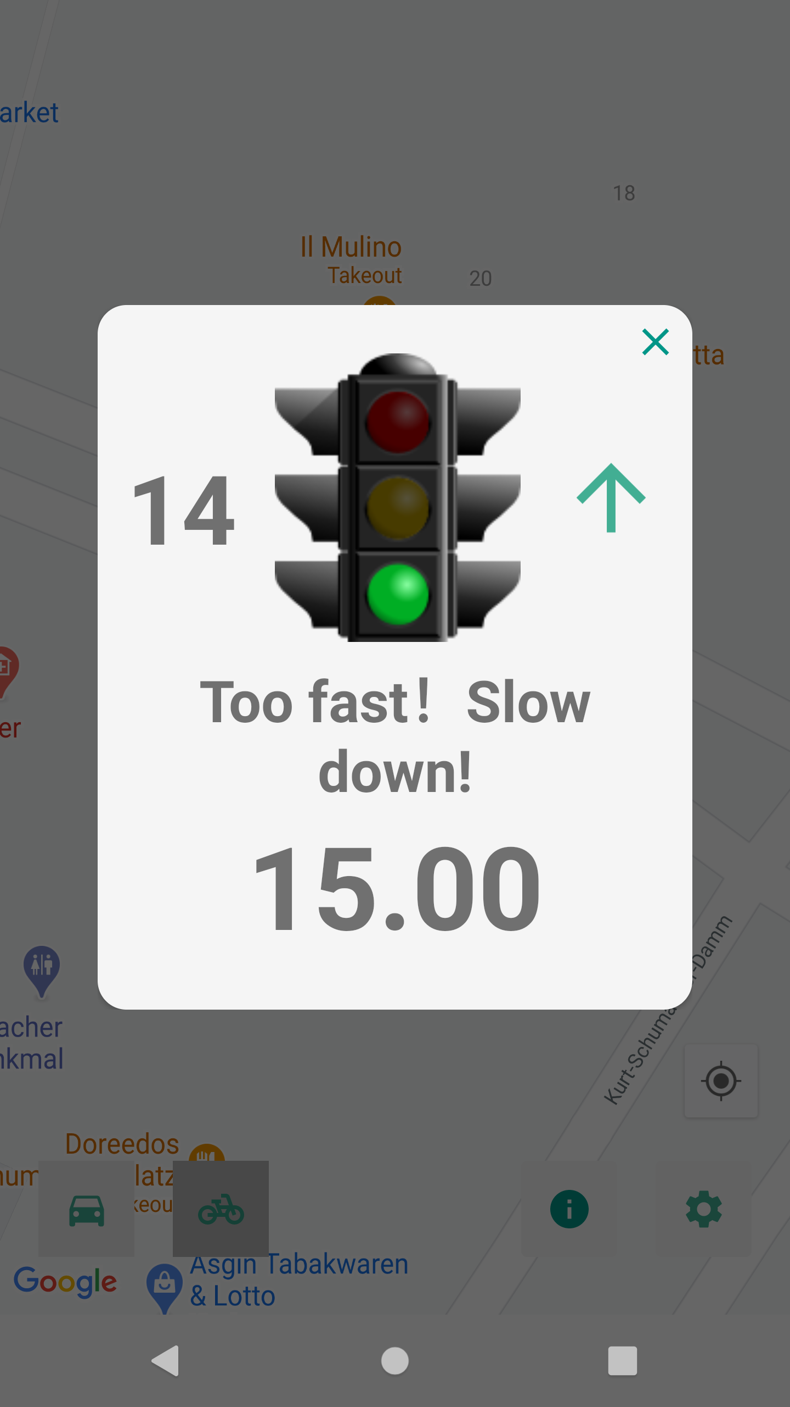
4. Layout (Popup Screen)
1
10.02.2021
DCAITI -Projekt

Slide 9
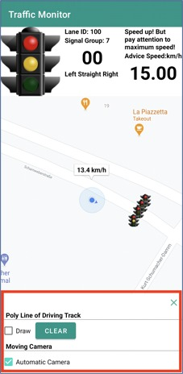
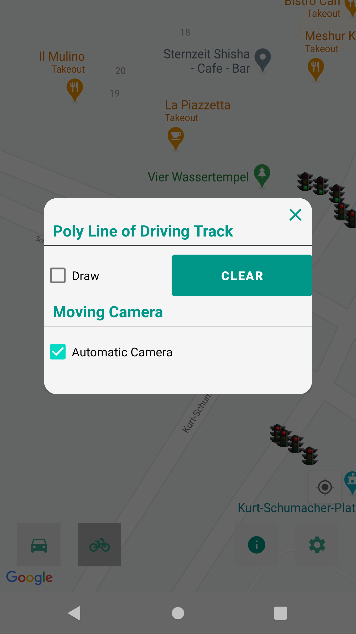
4. Layout (Settings Screen)
1
10.02.2021
DCAITI -Projekt

Slide 10
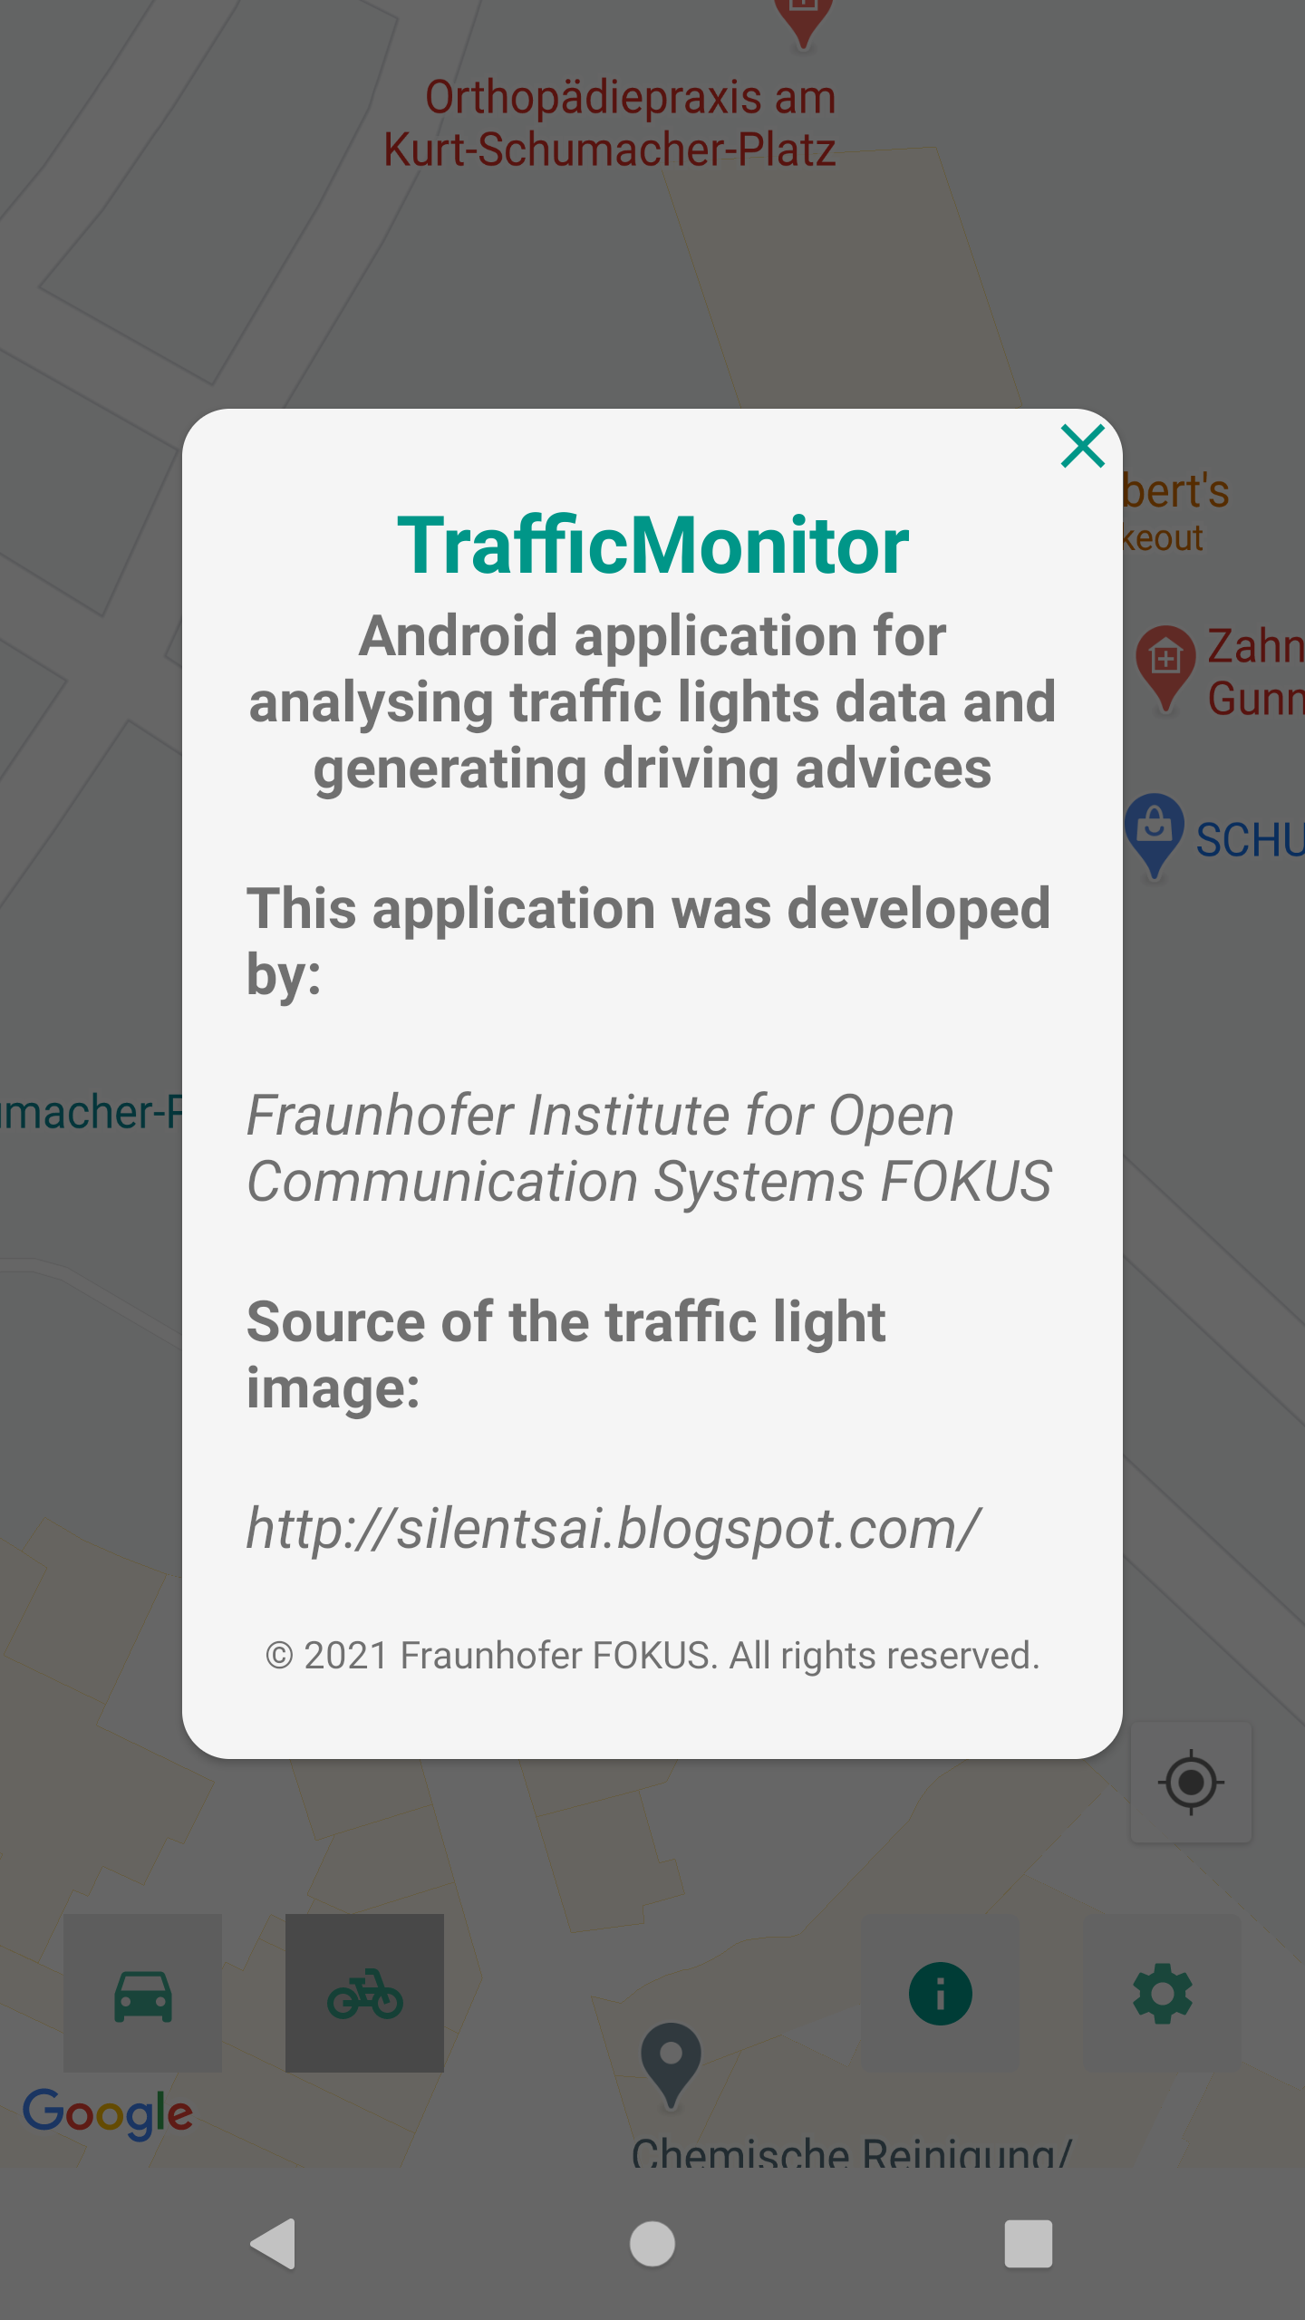
4. Layout (About Screen)
1
10.02.2021
DCAITI -Projekt

Slide 11
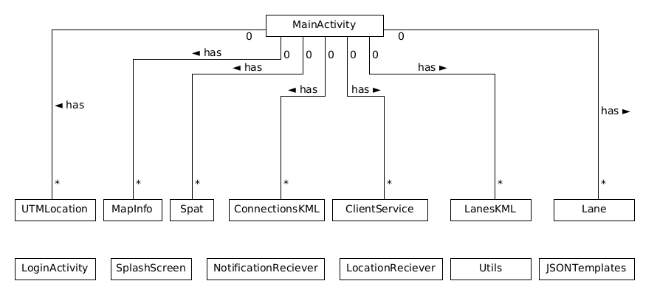
5. General Class Diagram
1
10.02.2021
DCAITI -Projekt

Slide 12
6. System Architecture
Android App
Backend
Frontend
Notification Receiver
Splash Screen
Local Resource
Lane Info
Client Service
User Info
Login Activity
DCAITI Server
Map Info
Spat Info
JSON Data
Location Receiver
Main Activity
Location Info
1
10.02.2021
DCAITI -Projekt

Slide 13
Request, analysis and visualization of traffic lights information
Determination of signal group
7. Main Tasks
Generation of strategies
1
10.02.2021
DCAITI -Projekt

Slide 14





7.1. Traffic Light Monitor: Implementation
Traffic light phase examples:
Client
Spat JSON
Dark
Move
Clear
JSON Parser
Current Time
Likely Time of State Stop
Time Left
Traffic Light Objects
Stop
Pre
Move
Clear
State Calculator
Current State & Time Left
Map View
1
10.02.2021
DCAITI -Projekt

Slide 15
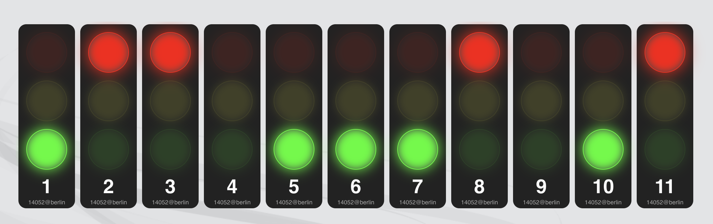
7.1. Traffic Light Monitor: Simulation & Test
Traffic lights contain 11 signal groups in intersection 14052
Every lane has one visual traffic light with the corresponding label about information of lane id and signal group id. Position Info from MapInfo JSON
Test, validation with the live view of dcaiti website, almost synchronous but our traffic lights delay a little bit (less than one second)
Source: https://werkzeug.dcaiti.tu-berlin.de/0432l770/trafficlights/
1
10.02.2021
DCAITI -Projekt

Slide 16
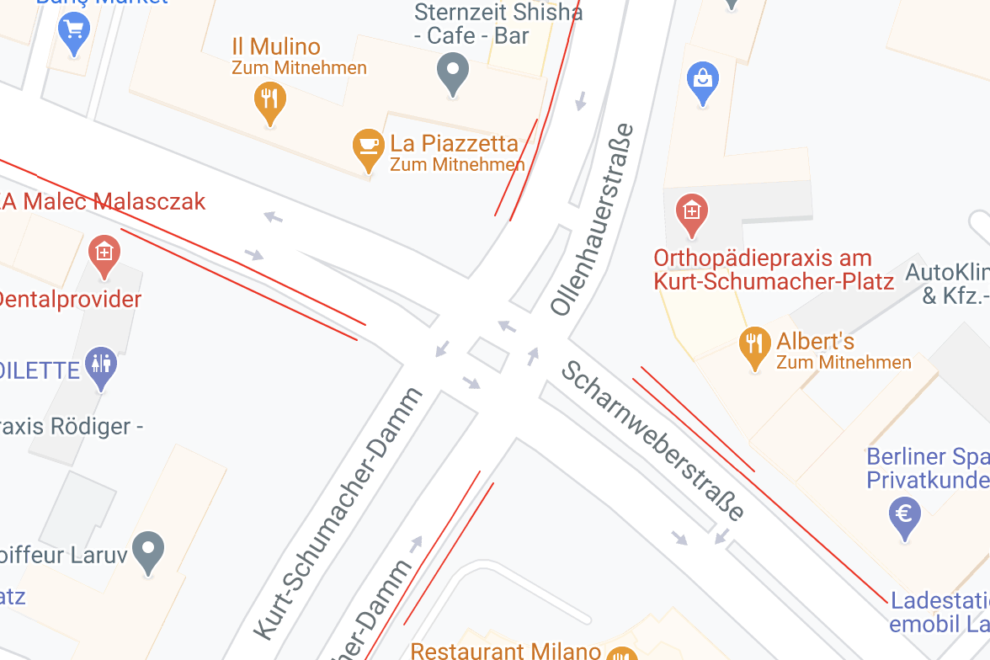
7.2. Determination: Implementation
Algorithm 1 :
Linear Regression -> Not suitable for real lane, which often in curve not straight line
Algorithm 2 :
Min. Distance to Lane Reference Points -> GPS not accurate at lane level
Algorithm 3 :
Drving mode & Min. Distance to Reference Points
Arm 2
Arm 1
Arm 4
Arm 3
Min. Distance to Reference Points
Which arm
Determination Result
Drving mode
Which lane at this arm
1
10.02.2021
DCAITI -Projekt

Slide 17
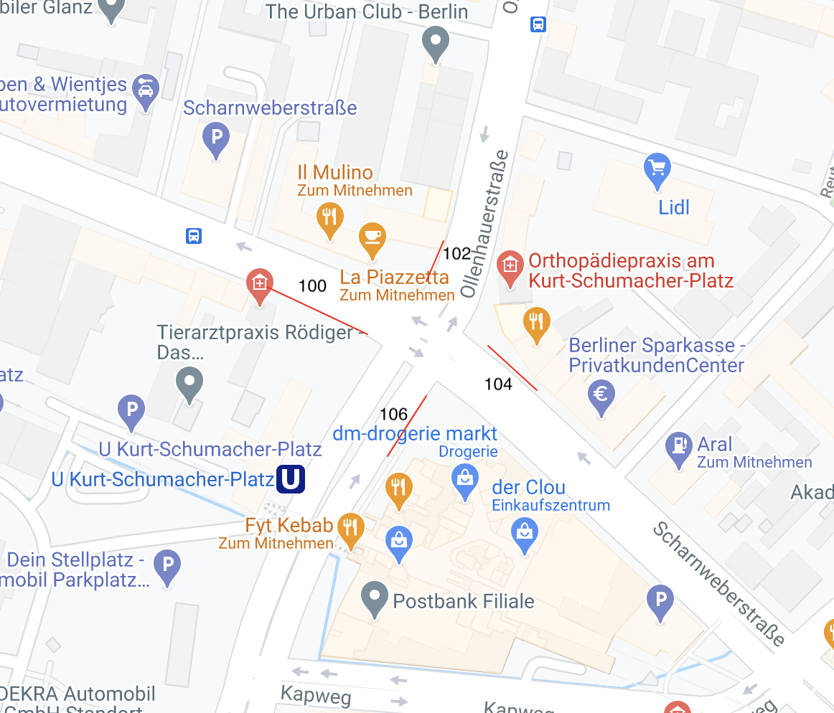
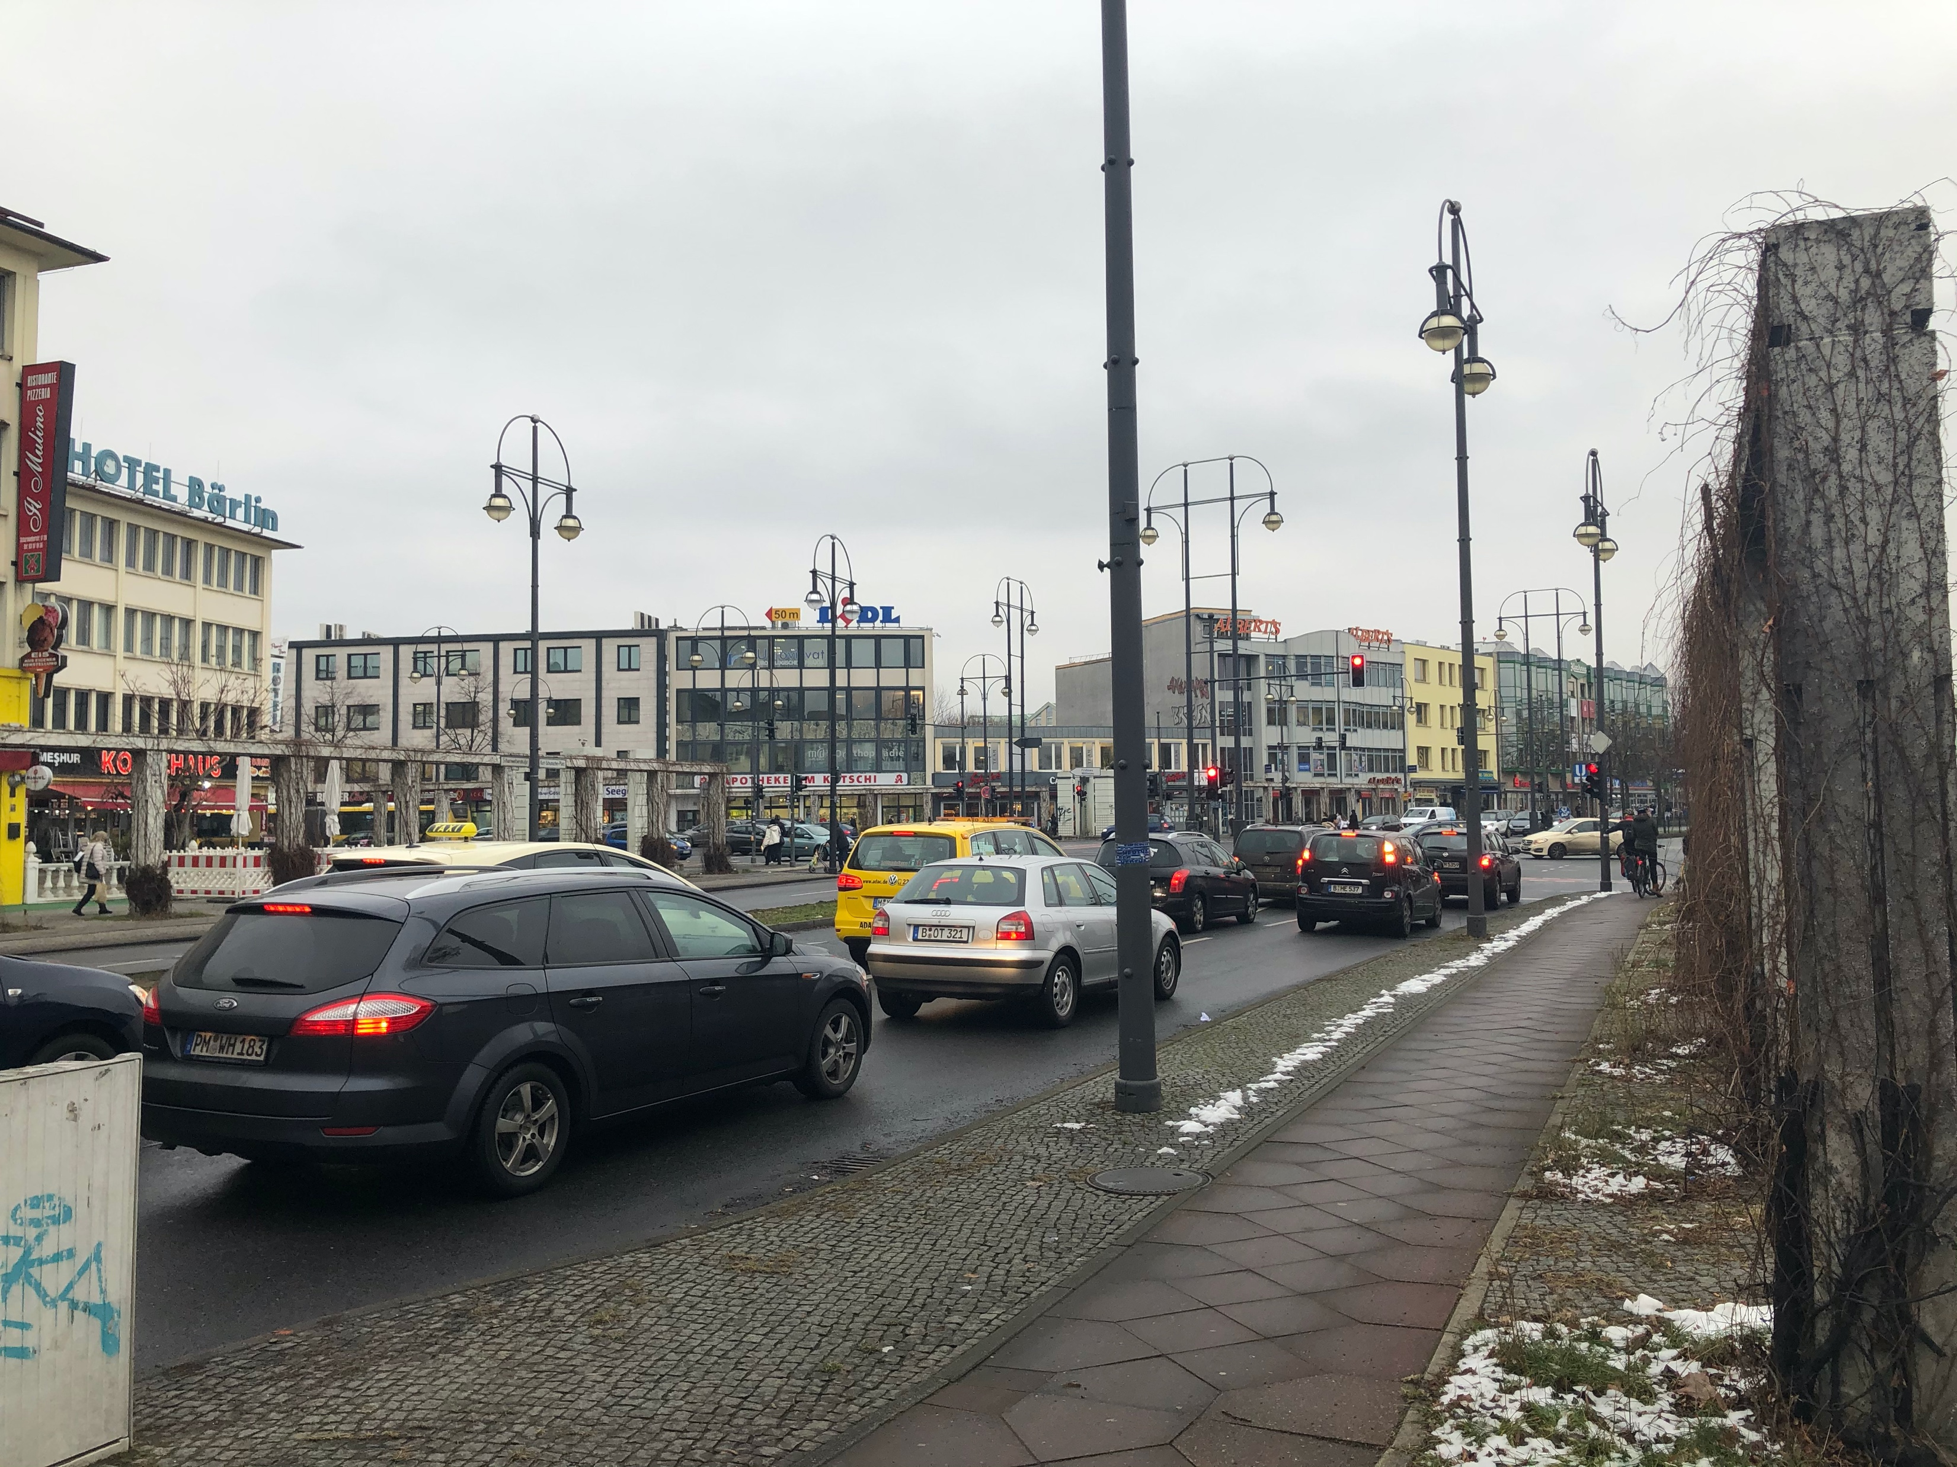
7.2. Determination: Simulation & Test
Testcases with handy at intersection 14052
Simulation of the bicycle users with the corresponding four driving directions in right picture
The determination results of lanes with id 100, 102, 104 and 106 are expected
Source : Photo of the arm 1 of intersection 14052 taken by Yiyang and contains bicycle lane 100
1
10.02.2021
DCAITI -Projekt

Slide 18

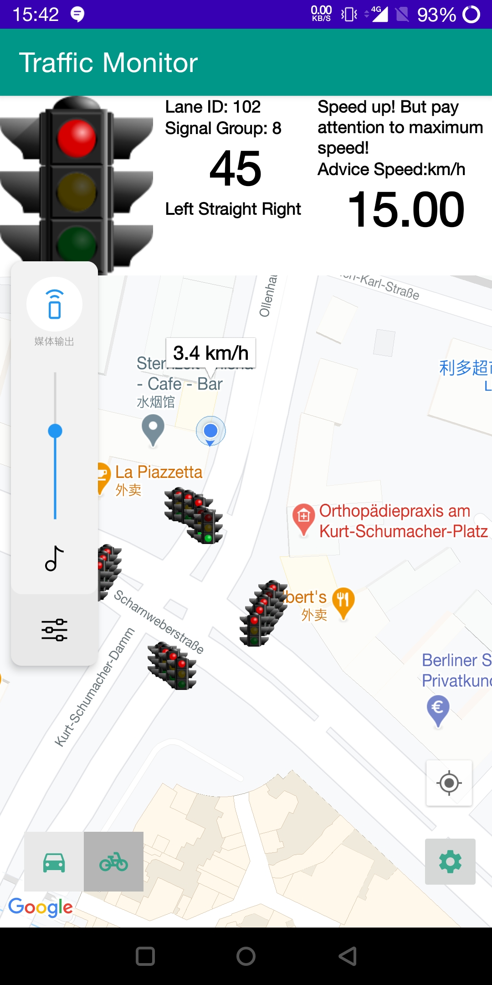
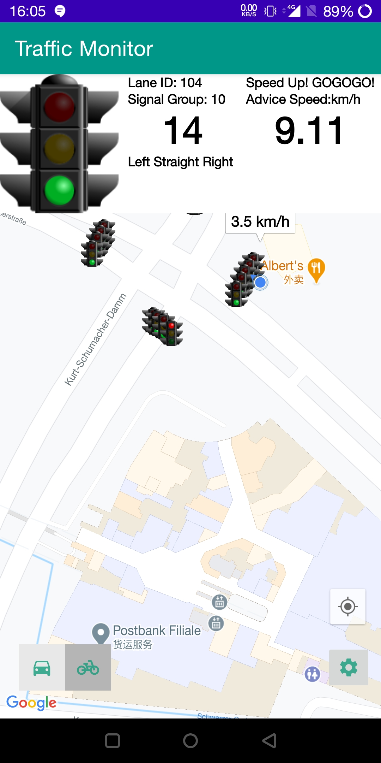
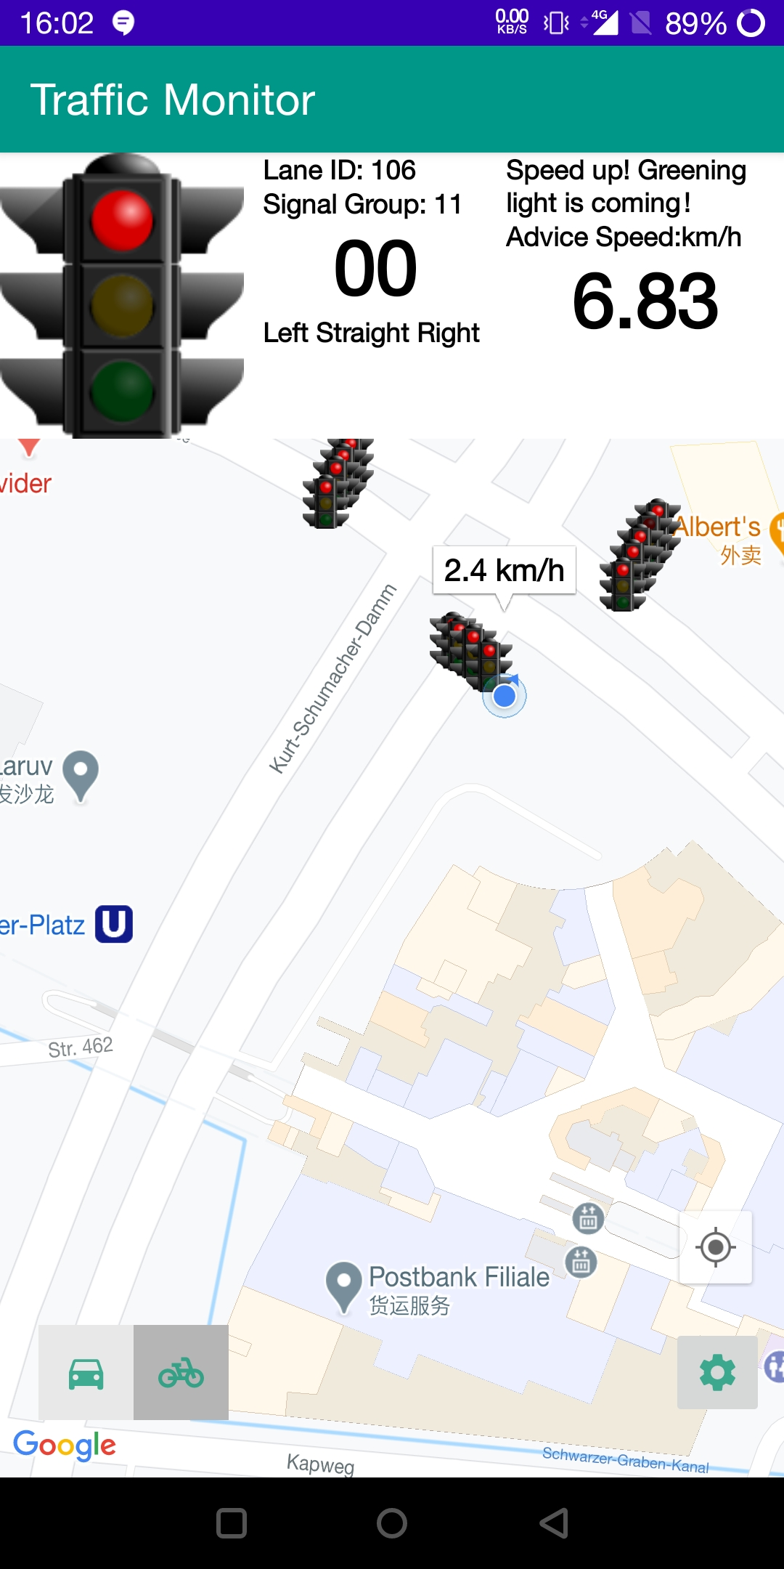
7.2. Determination: Simulation & Test
Test results with handy at intersection 14052
The lanes with id 100, 102, 104 and 106 are determined successfully.
1
10.02.2021
DCAITI -Projekt

Slide 19
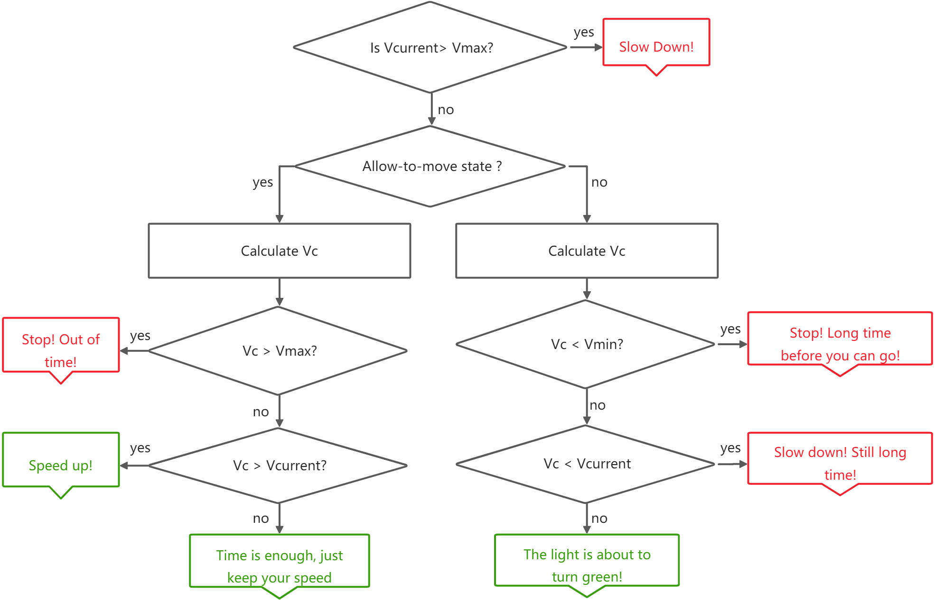
7.3. Driving Strategies: Implementation
Stop
Pre
Move
Clear
[6]
[5]
[4]
[3]
[2]
[1]
Vcurrent: current speed
Vmax: maximum permitted speed
Vmin: minimum permitted speed
Vc: calculated speed to reach the intersection in the remaining time
[1]
[6]
[2]
[5]
[3]
[4]
1
10.02.2021
DCAITI -Projekt

Slide 20
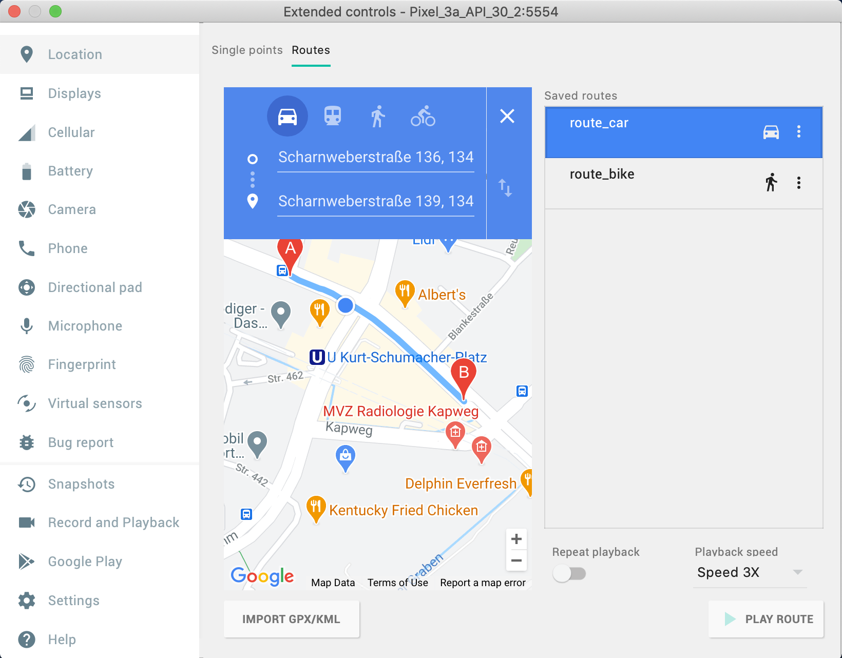
7.3. Driving Strategies: Simulation & Test
Route Simulation with Emulator
For example: the route of car with Speed 3X: around 45 km/h
1
10.02.2021
DCAITI -Projekt

Slide 21
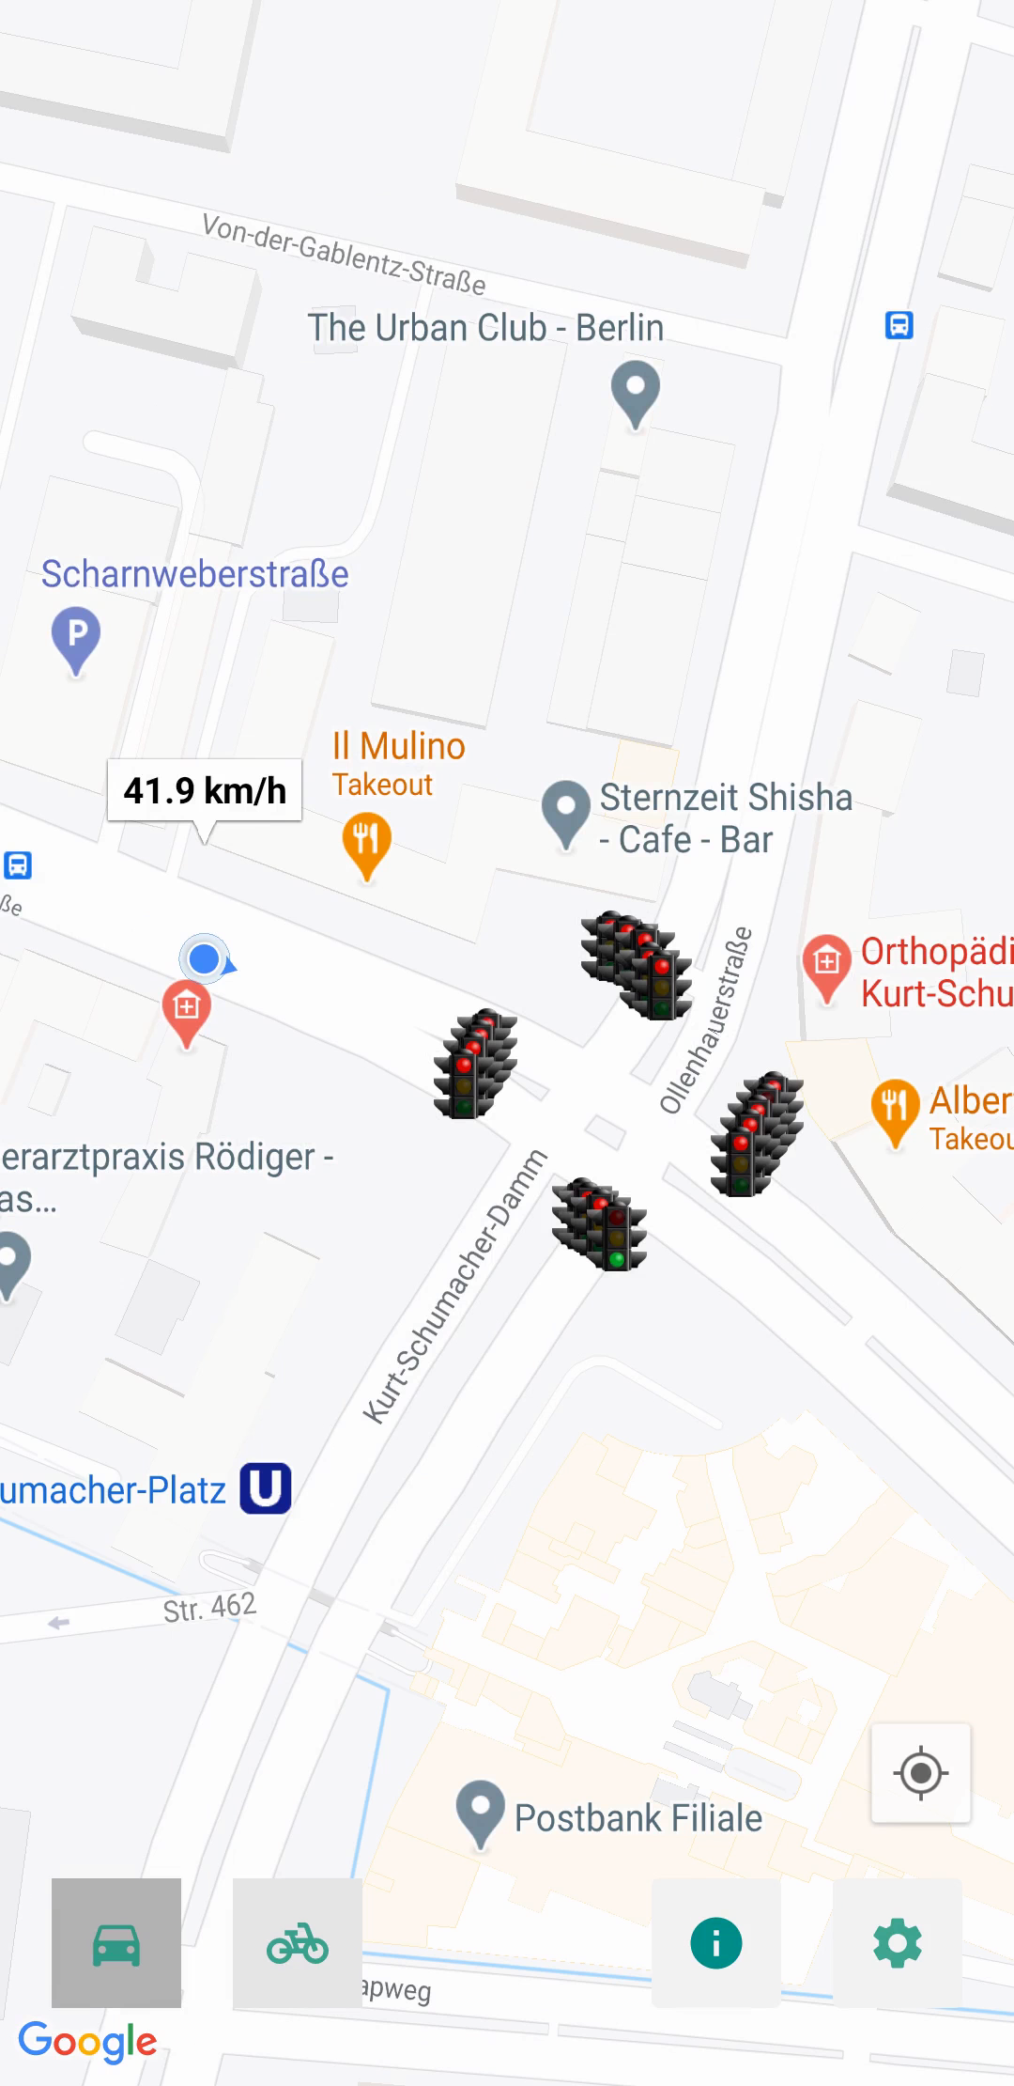
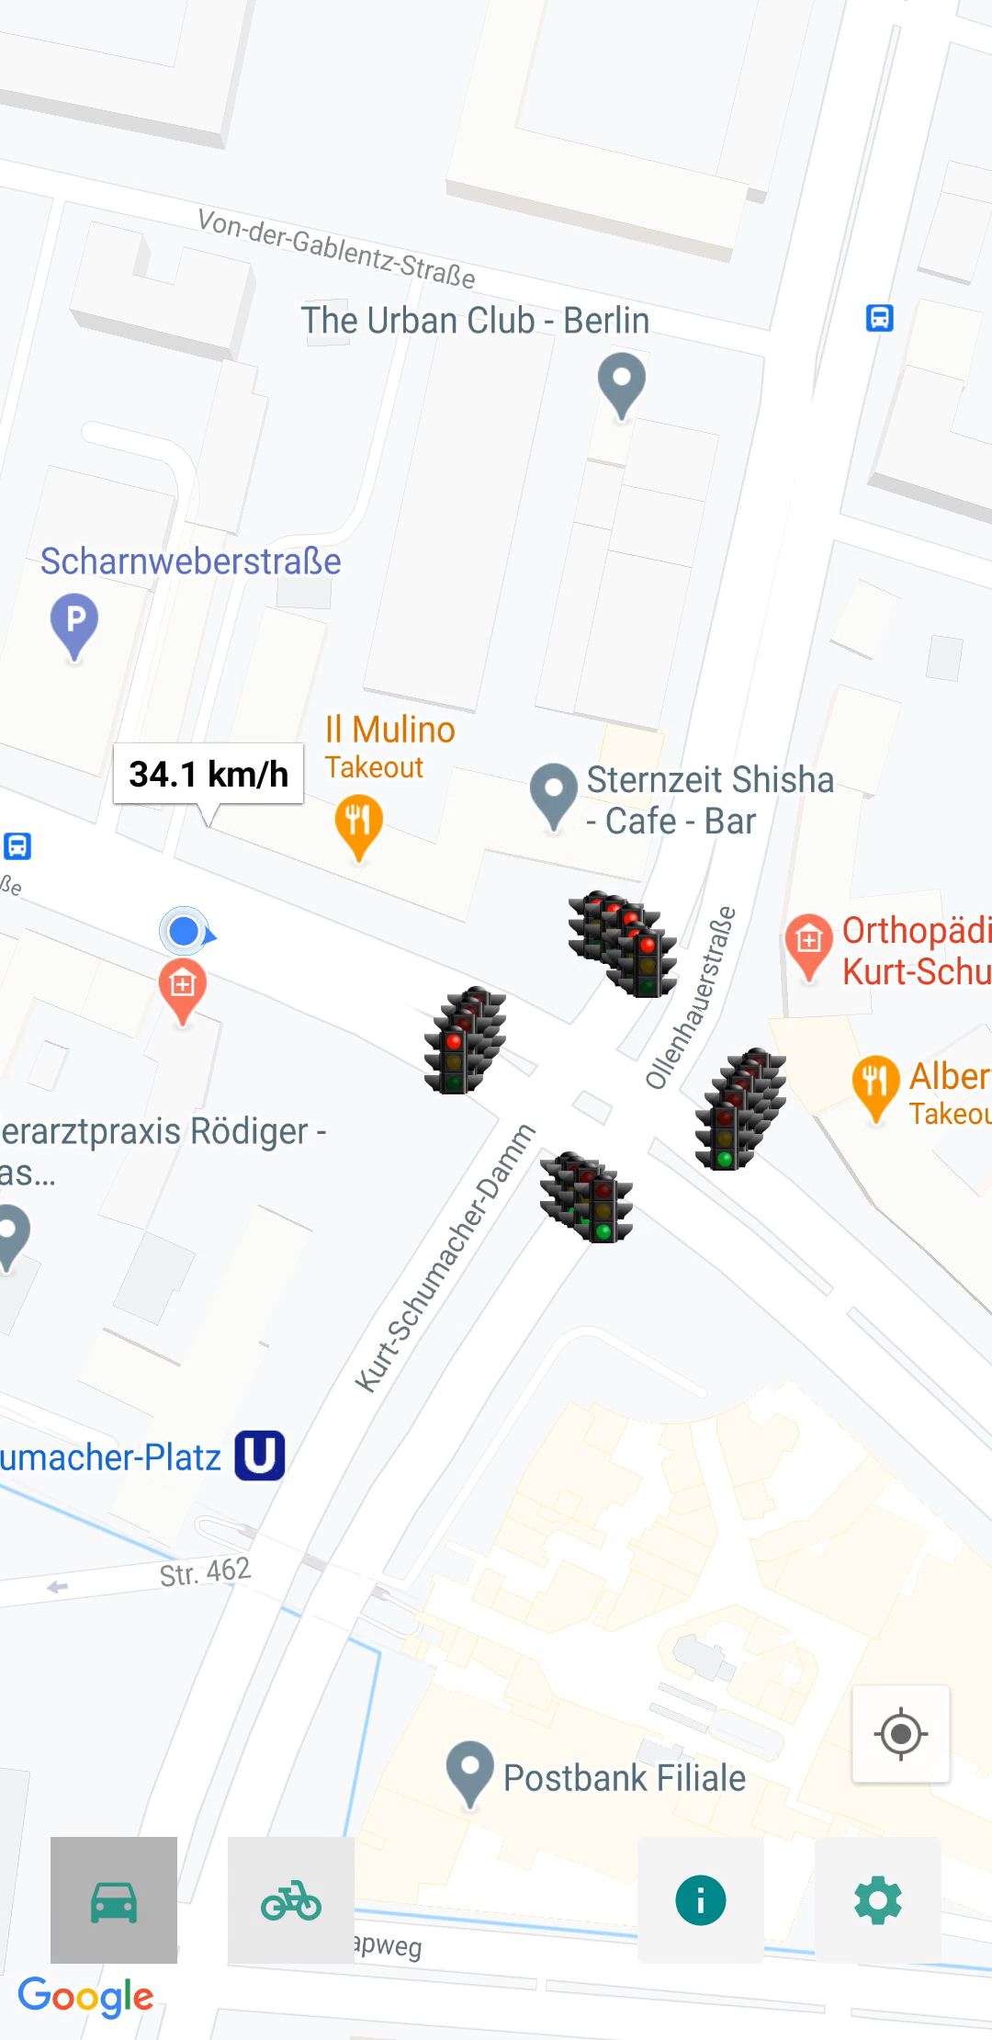
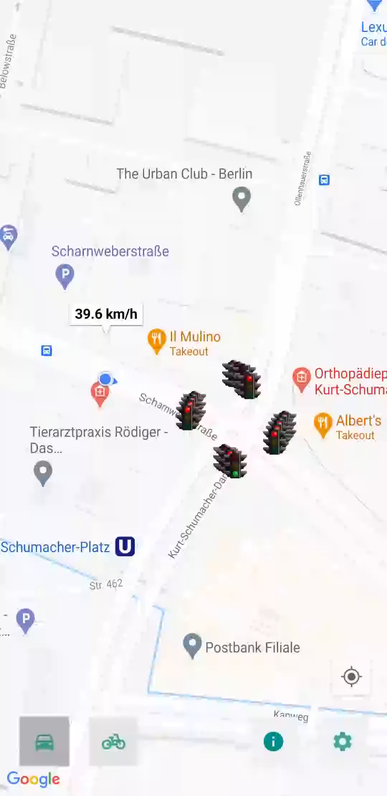
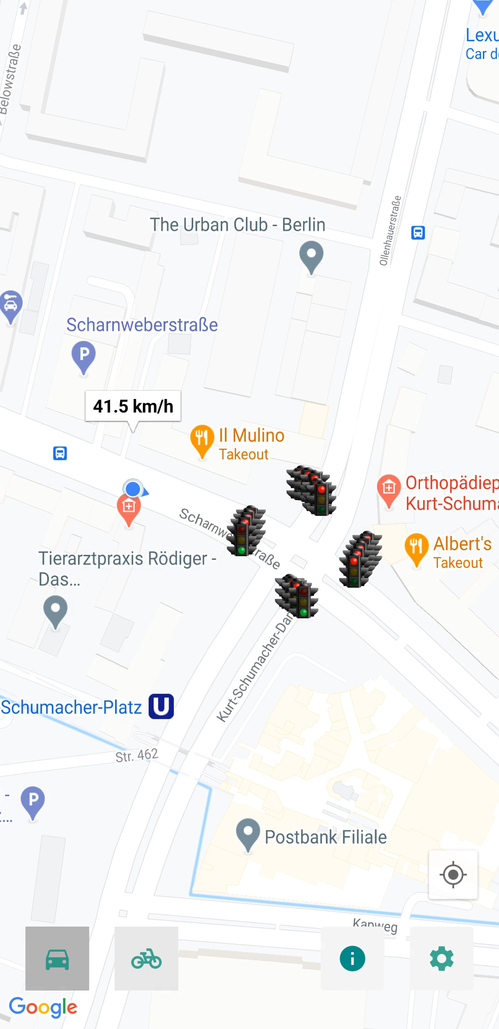
7.3. Driving Strategies: Simulation & Test
Case No.1: Car;
State: Move & Clear;
Enough time to pass
Case No.2: Car;
State: Move & Clear;
No enough time to pass
Case No.3: Car;
State: Stop & Pre;
Long time to wait for green
Case No.4: Car;
State: Stop & Pre;
Green light is about to come
1
10.02.2021
DCAITI -Projekt
Notes:
<number>

Slide 22
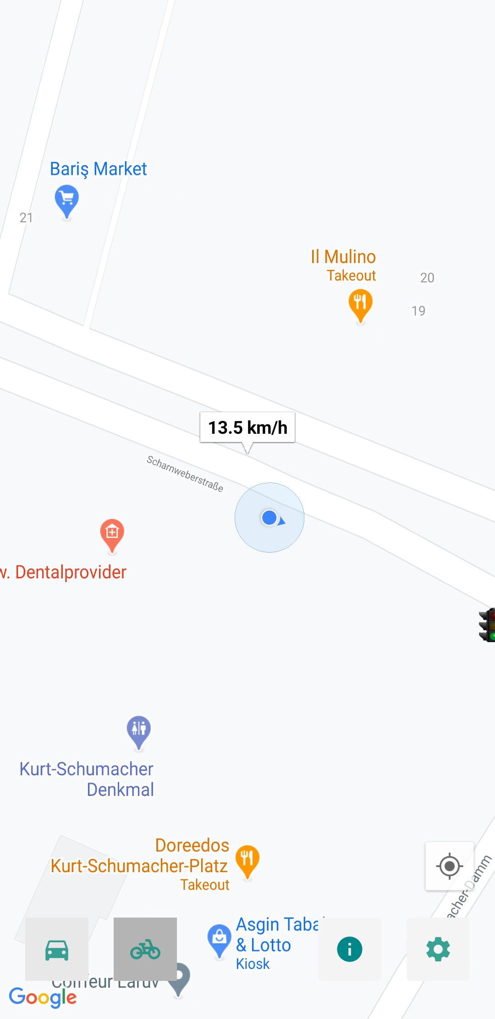
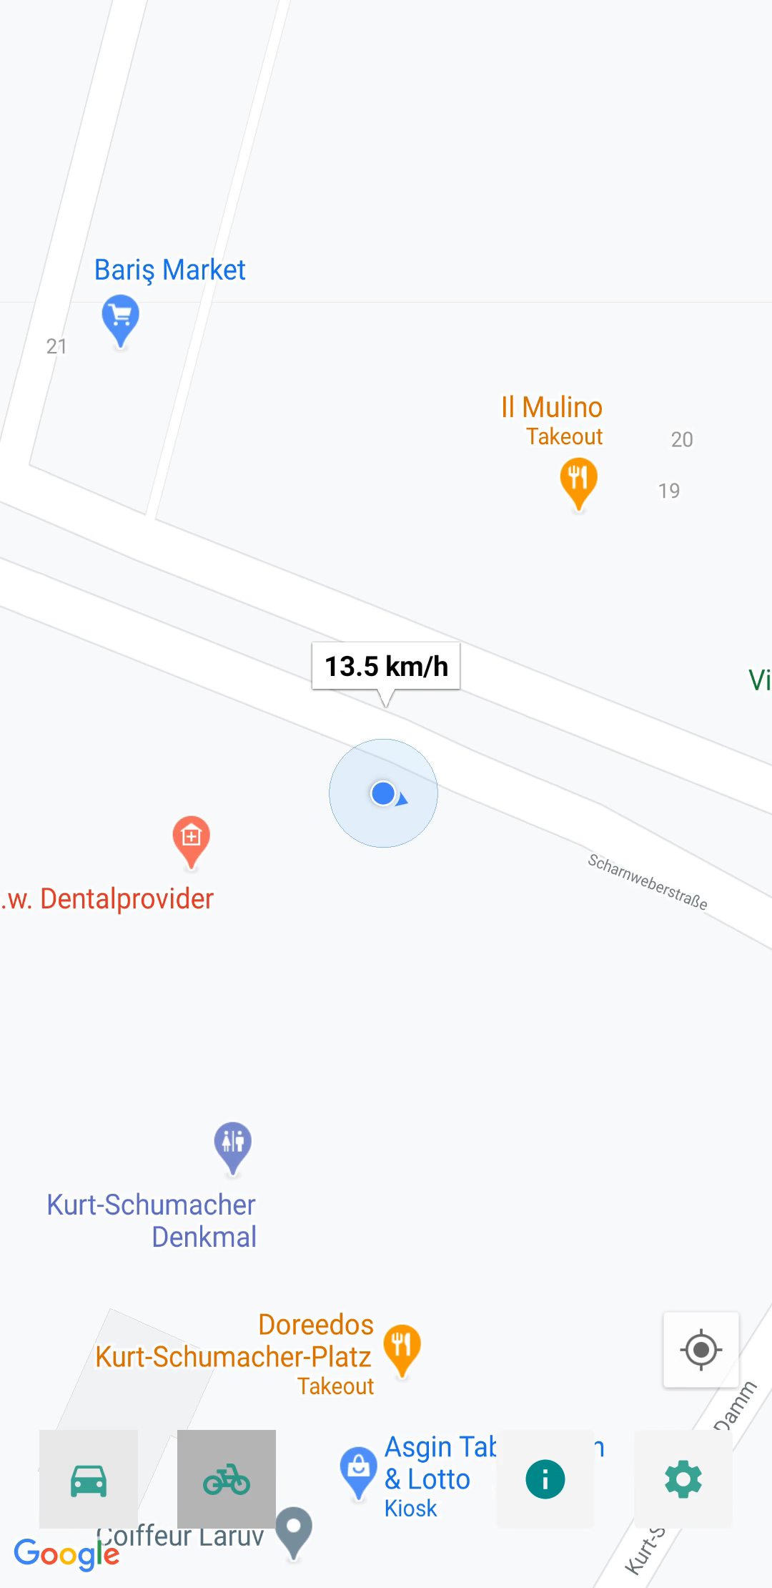
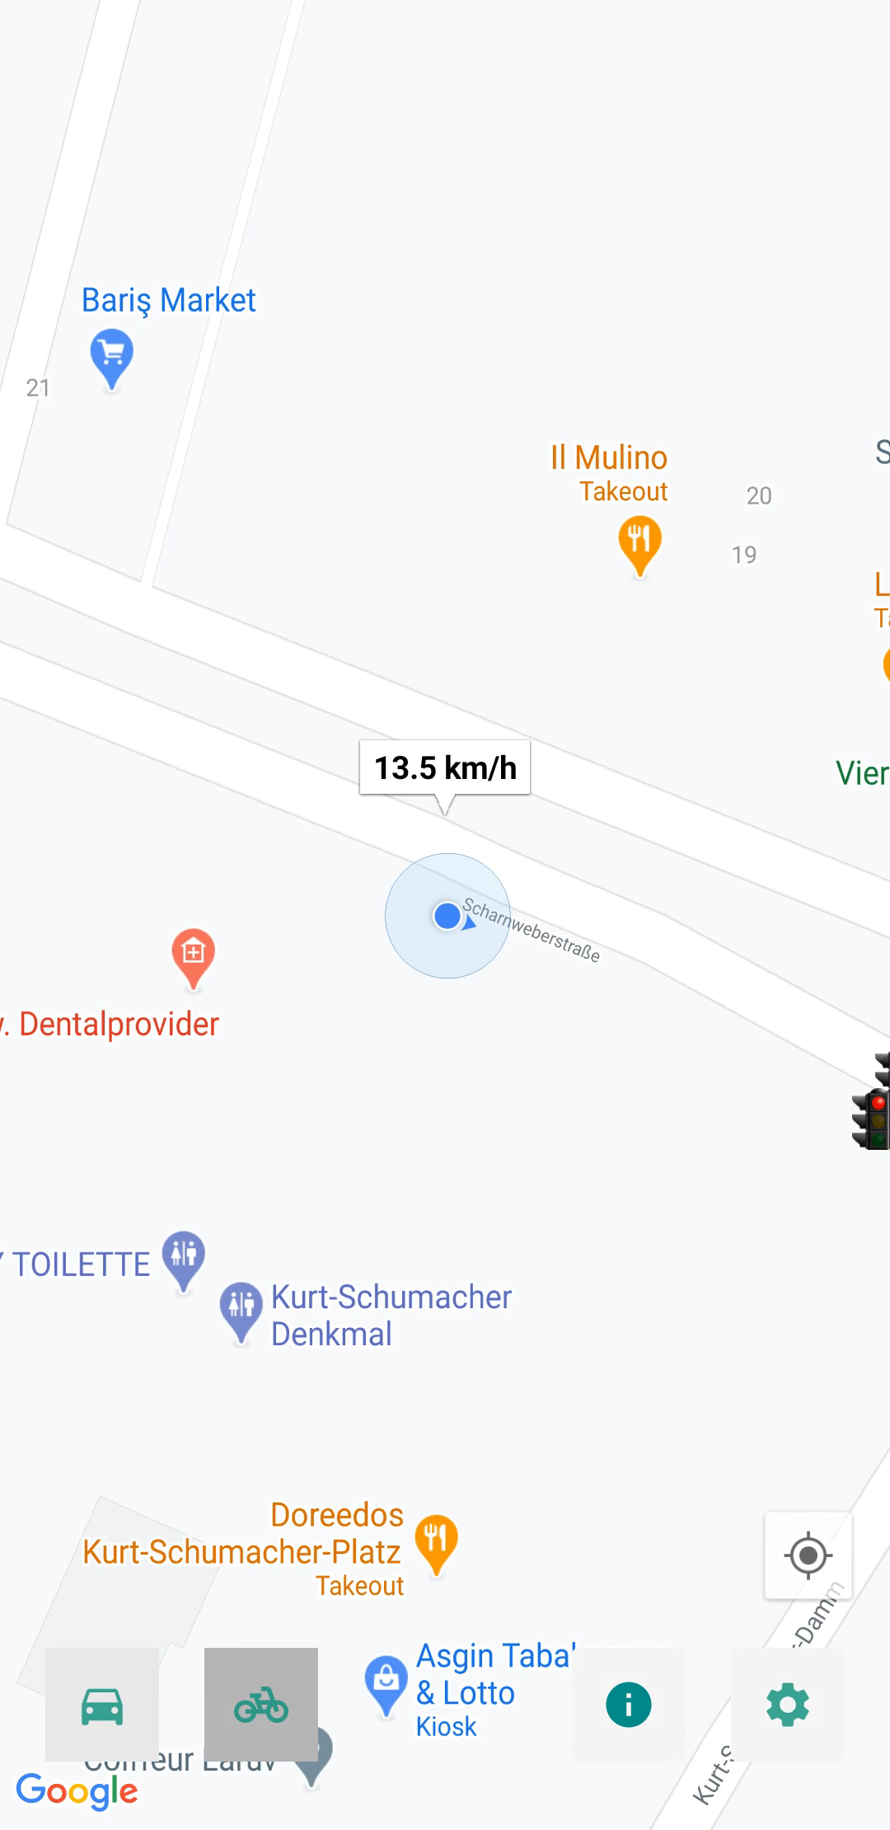
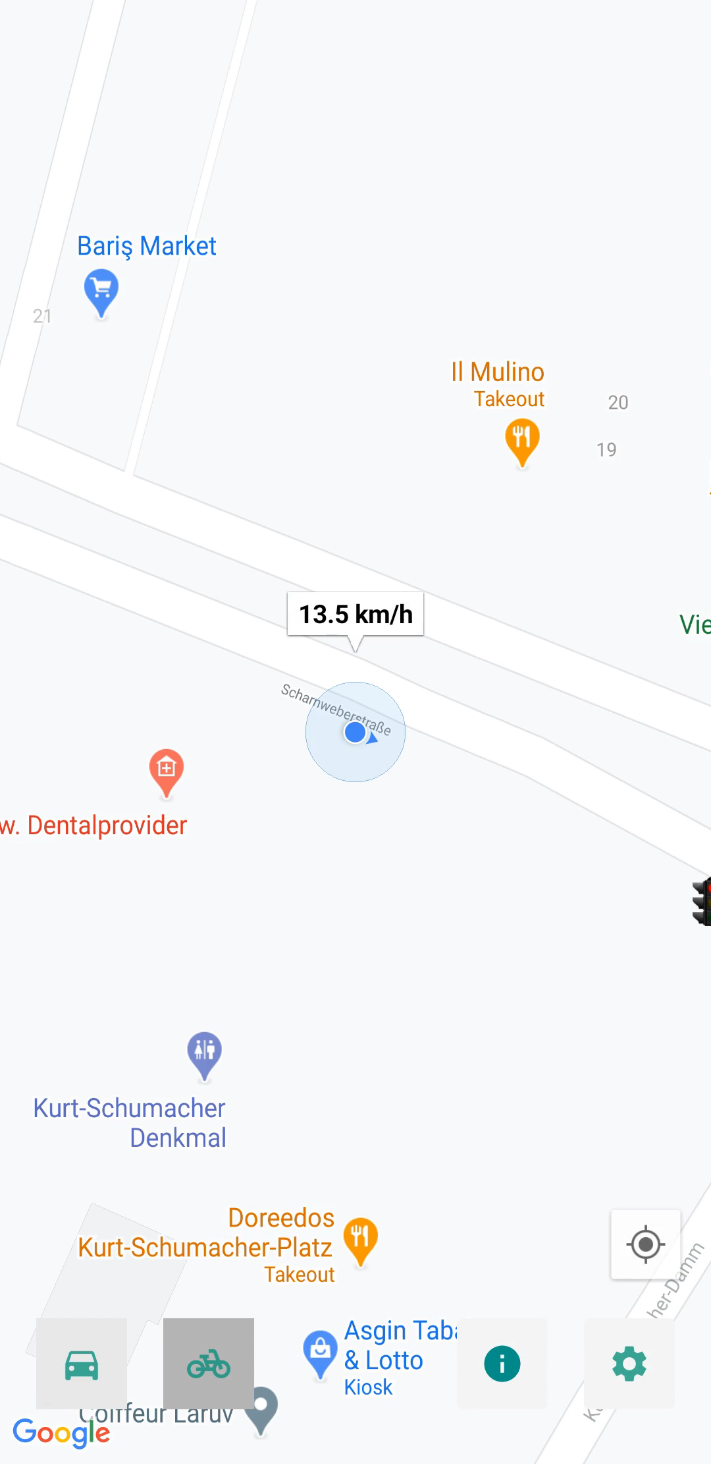
7.3. Driving Strategies: Simulation & Test
Case No.5: Bicycle;
State: Move & Clear;
Enough time to pass
Case No.6: Bicycle;
State: Move & Clear;
No enough time to pass
Case No.7: Bicycle;
State: Stop & Pre;
Long time to wait for green
Case No.8: Bicycle;
State: Stop & Pre;
Green light is about to come
1
10.02.2021
DCAITI -Projekt
Notes:
<number>

Slide 23
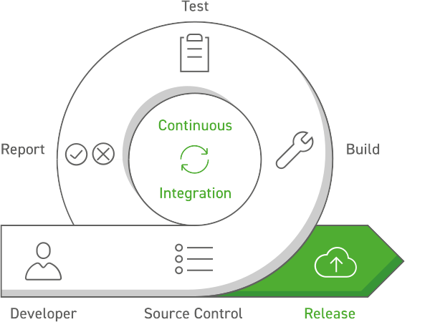
8. Jenkins – Plugin
Makes team work easear
Writing unit tests using Android testing libraries
This cycle runs automatically after each commit
Checks outdated packages
Source: https://www.kubes.ch/labview-jenkins-plugin/

Slide 24
9. Milestones
<number>
10.02.2021
DCAITI -Projekt

Slide 25
10. Licenses
Source of the traffic light image: http://silentsai.blogspot.com/
<number>
10.02.2021
DCAITI -Projekt

Slide 26
Thanks for your attention!
Oday Kabha oday.kabha@ipk.fraunhofer.de
Yiyang Song yiyang.song@campus.tu-berlin.de
Yuanheng Mu johanmu1994@mailbox.tu-berlin.de
Notes:
<number>

